Slide 1
Brain Stroke Prediction
Team Members:
Gattu Snehalatha(21AG1A05F0)
Bhukya Paramesh (21AG1A05D4)
Billakanti Vardhan(21AG1A05D5)
Bommaraju Nikhil Sai (21AG1A05D3)
Gannoju Shivani (21AG1A05E9)
Sanike Ushasri (21AG1A05I1)
Shivanoor Ratnesh (21AG1A05I2)
Simharajula Akshay (21AG1A05I3)
Mailugani Saikiran (22AG5A0515)
Mohammad Riyaz(22AG5A0520)
Under the guidance of:
Mr. D. Krishna
Associate Professor,
CSE Department.

Slide 2
INTRODUCTION TO BRAIN STROKE PREDICTION
A brain stroke, also known as a cerebrovascular accident (CVA) or stroke, occurs when the blood supply to a part of the brain is interrupted or reduced, depriving brain tissue of oxygen and nutrients. This can happen due to a blockage in an artery (ischemic stroke) or the rupture of a blood vessel ( hemorrhagic stroke).
The lack of oxygen and nutrients can cause brain cells to die within minutes, leading to various symptoms such as sudden weakness or numbness on one side of the body, trouble speaking or understanding speech, vision problems, severe headache, dizziness, and loss of balance or coordination.

Slide 3

LOGISTIC REGRESSION
Logistic regression is basically a supervised classification algorithm. In a classification problem, the target variable(or output), y, can take only discrete values for a given set of features(or inputs), X. Contrary to popular belief, logistic regression is a regression model. The model builds a regression model to predict the probability that a given data entry belongs to the category numbered as “1”. Just like Linear regression assumes that the data follows a linear function,
Logistic regression models the data using the sigmoid function.
FORMULA :

Slide 4
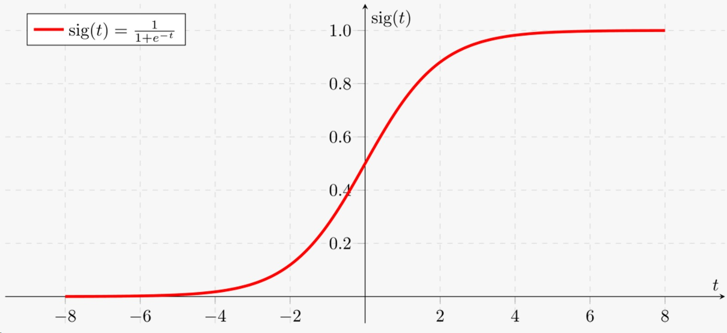

Slide 5
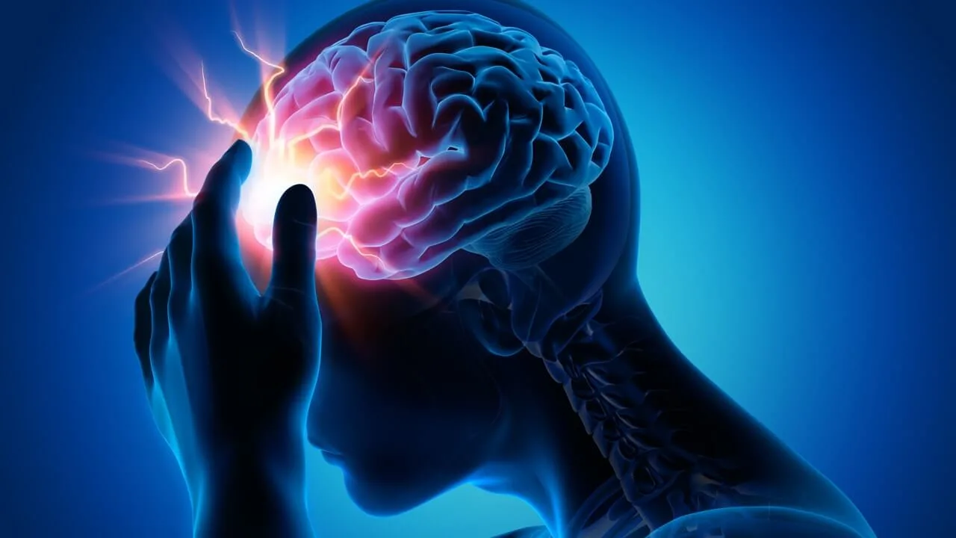
Our Project Goal:
The Goal is to predict whether a person is having a brain stroke or not.

Slide 6
DATASET DETAILS
The dataset we have chosen is from kaggle repository. This dataset provides patients information. This dataset consists of over 4981 rows and 11 columns. Target variable or Dependent variable:
Stroke: Whether the instance of the dataset has brain stroke or not.
Independent variable:
Gender: Gender of the person.
Age: Age of the person.
Hypertension: The hypertension level of a person.
Ever_married: Whether the person is married or not.
Work_type: Type of work.
Residence_type: Type of residence.
Avg_glucose_level: Glucose level of a person.
Bmi: Body Mass Index.
Smoking status: Whether the person smokes or not.

Slide 7
LIBRARIES USED
NumPy: NumPy is a popular Python library used for numerical computing.
Pandas: Data processing, CSV file I/O (e.g. pd.read_csv).
Matplotlib: Creating static, interactive, and animated visualizations in Python.
Seaborn: Data visualizations.
Sklearn: Popular library used for calculating the metrics, accuracy score and to build confusion matrix.

Slide 8
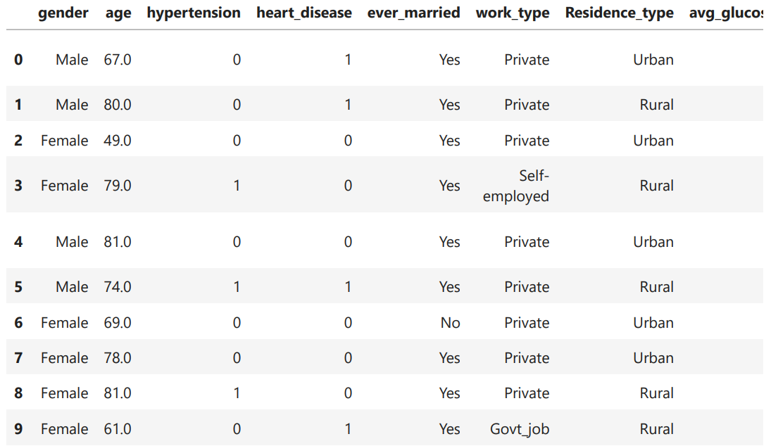
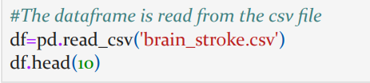
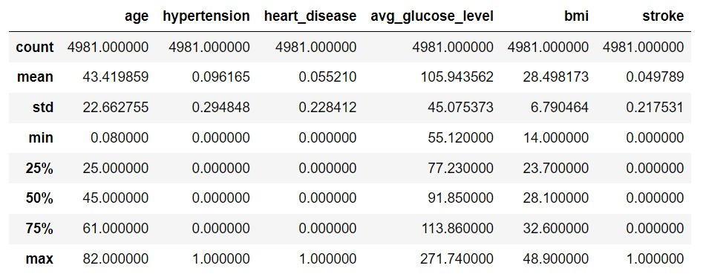

DATA EXPLORATION

Slide 9
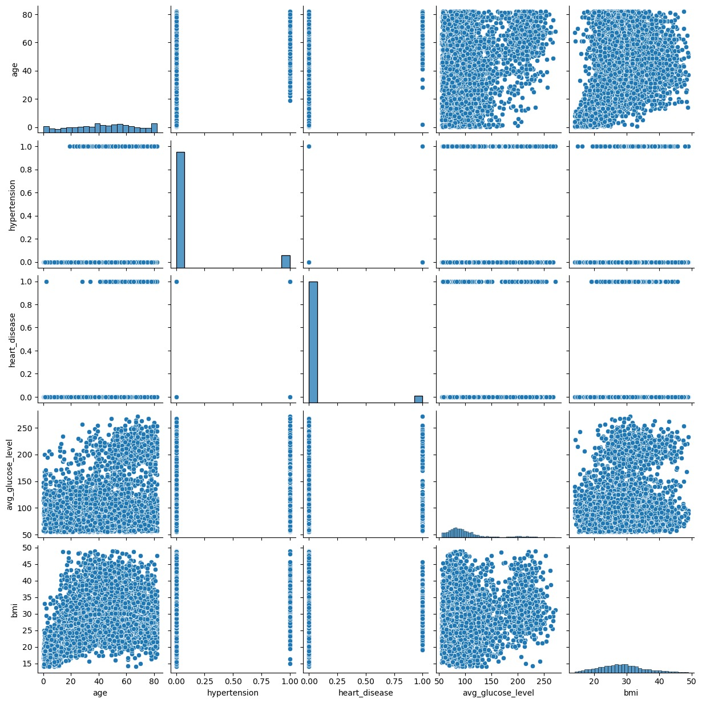
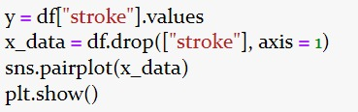
DATA VISUALISATION

Slide 10
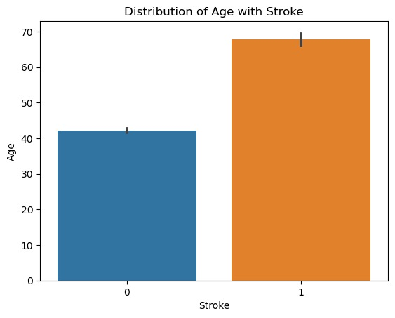
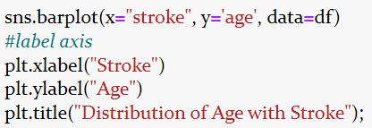
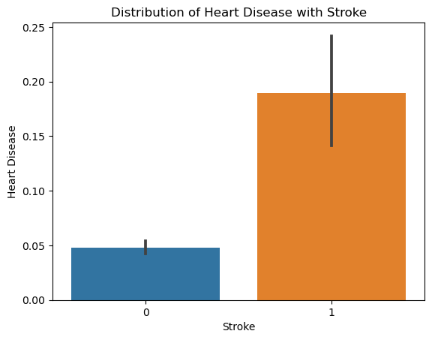
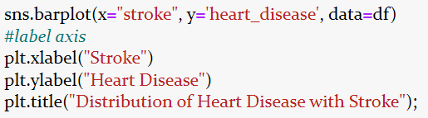

Slide 11
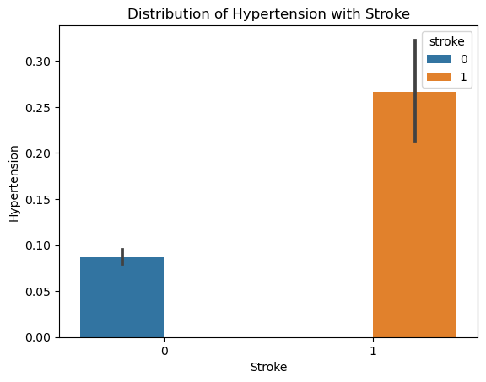
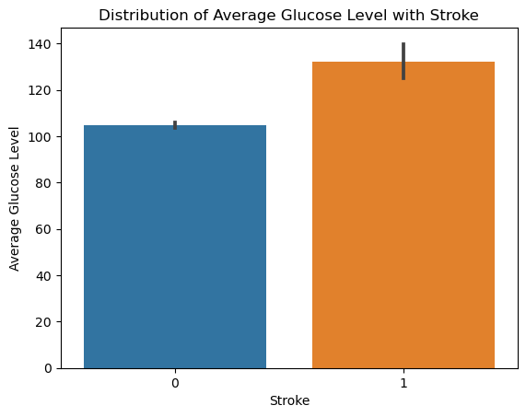
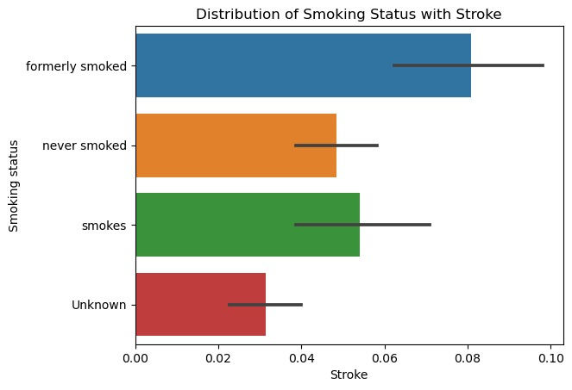
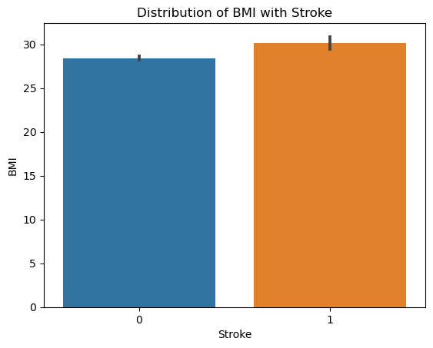

Slide 12
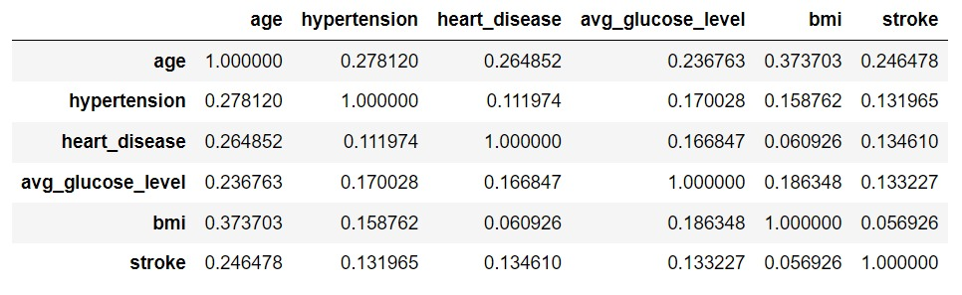
CORRELATION ANALYSIS

Slide 13
CORRELATION MATRIX
A correlation matrix is a table showing correlation coefficients between variables. Each cell in the table represents the correlation between two variables. The correlation coefficient can range from -1 to 1,
where:
1 indicates a perfect positive correlation
-1 indicates a perfect negative correlation
0 indicates no correlation
A correlation matrix is often used in statistics and data analysis to understand the relationship between different variables in a dataset. It helps identify patterns and dependencies among variables.

Slide 14
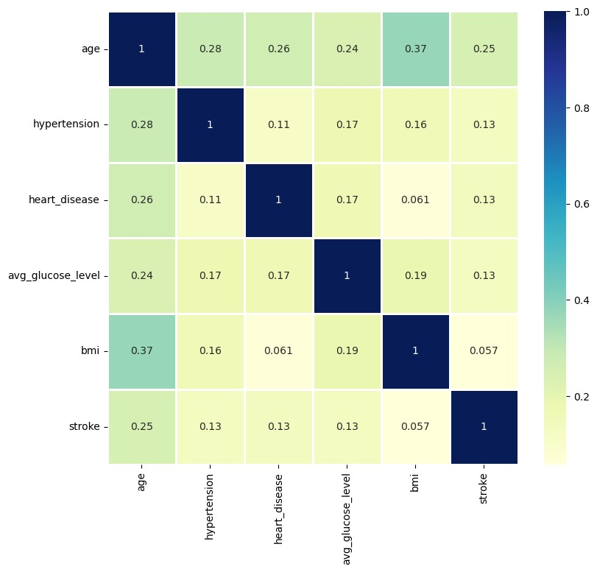
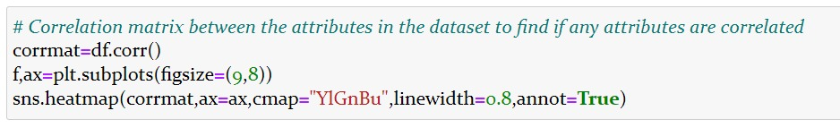
CORRELATION MATRIX

Slide 15
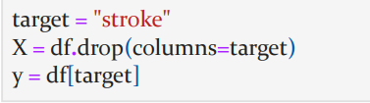
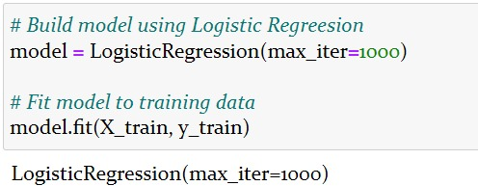
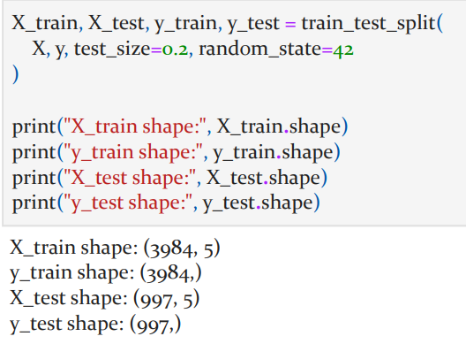
MODEL BUILDING AND EVALUATION
[Logistic Regression]

Slide 16
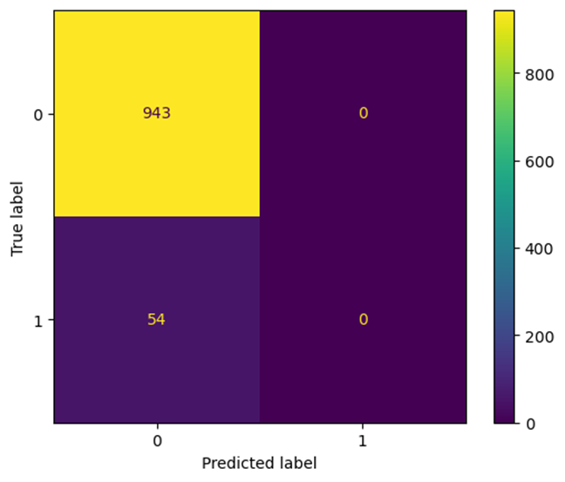
CONFUSION MATRIX

Slide 17
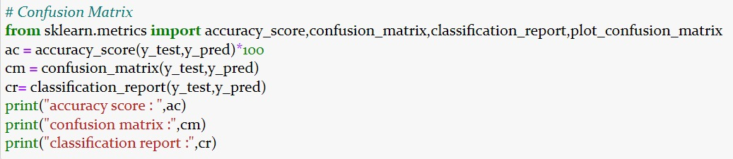
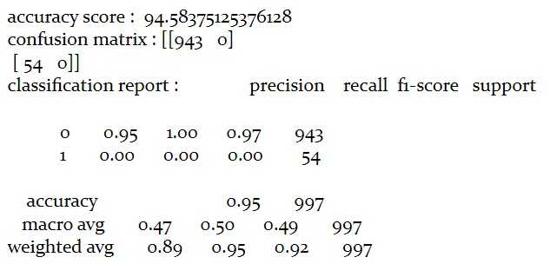
CLASSIFICATION REPORT

Slide 18
CONCLUSION
The model shows that every parameter or features are directly proportional to the dependent variable stroke.
This model almost predicts the brain stroke chances of a person correctly.
The model is predicted with 0.95 accuracy.

Slide 19
BIBILOGRAPHY
Dataset Link:- https://www.kaggle.com/code/inkoomgeorge/brain-stroke-prediction-with-logistic-regression/input
YouTube Reference Video:- https://www.youtube.com/watch?v=SShYVKOpSAE&t=1615s
Regression Analysis using Python:-
https://www.kaggle.com/code/inkoomgeorge/brain-stroke-prediction-with-logistic-regression

Slide 20


